Slide 1
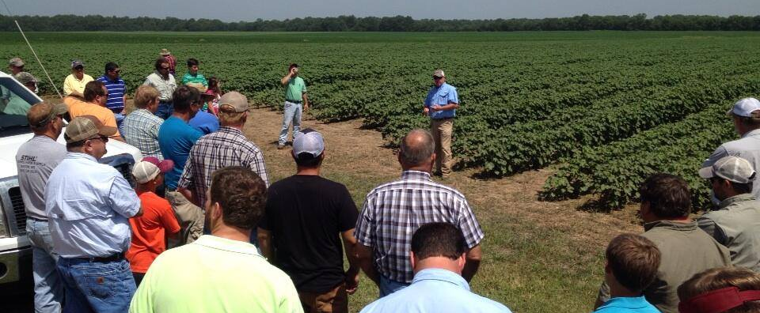
CTO Theme Presentation
(with background image)

Slide 2
CTO Theme Presentation
(no background image)
These themes can be accessed from the “Layout” dropdown
menu in the Home tab.

Slide 3
CTO Theme Presentation
(sidebar)

Slide 4
CTO Color Scheme
RGB + Hexadecimal (screen use only)
102, 0, 0
59, 126, 133
140, 203, 203
149, 141, 95
104, 132, 63
161, 176, 92
221, 209, 117
194, 223, 238
130, 134, 140
#660000
#3B7E85
#8CCBCB
#958D5F
#68843F
#A1B05C
#DDD175
#C2DFEE
#82868C

Slide 5
CTO Color Scheme
Pantone + CMYK (print use only)
P 202
P 5473
P 7464
P 7536
P 575
P 583
P 7403
P 544
P 7544
31, 98, 71, 31
78, 36, 43, 8
44, 3, 21, 0
42, 36, 71, 8
62, 31, 93, 13
41, 18, 80, 1
15, 11, 66, 0
22, 3, 3, 0
52, 42, 38, 4

Slide 6
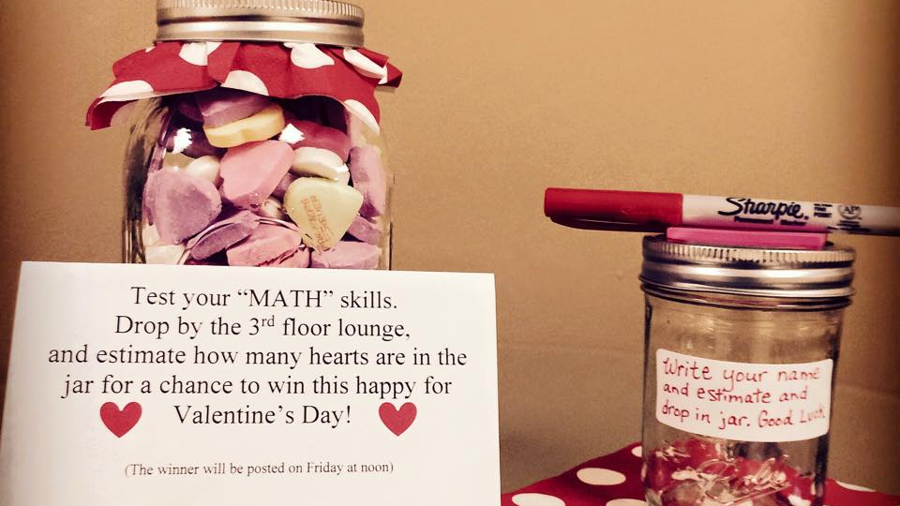
A single image with a title
And a description that can go here.

Slide 7
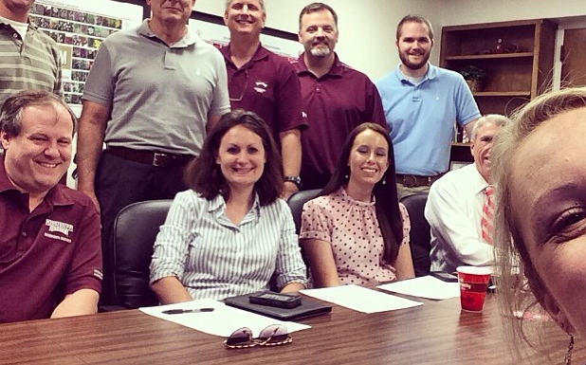
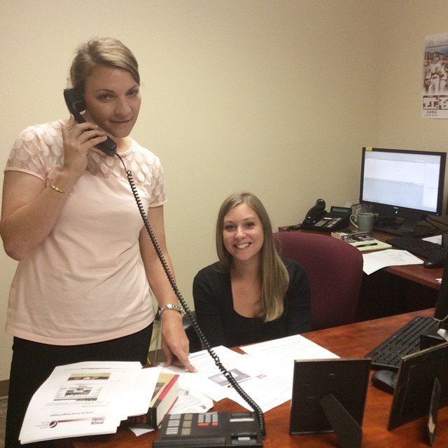
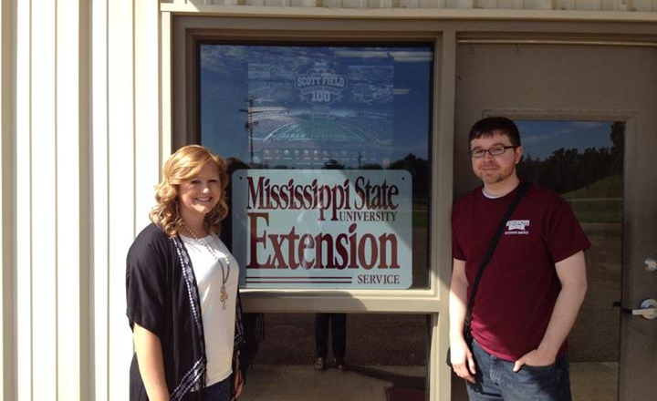
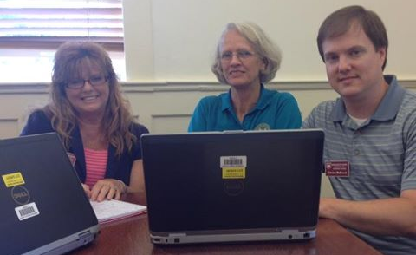

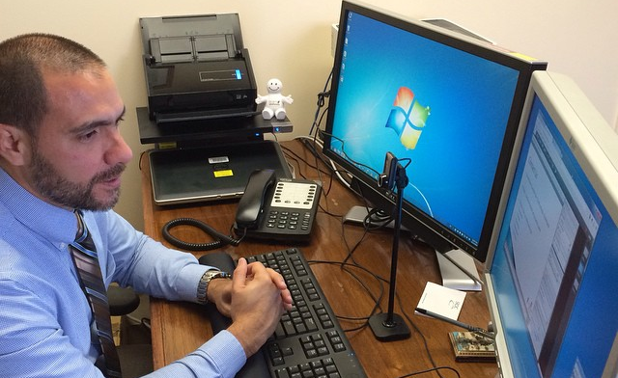
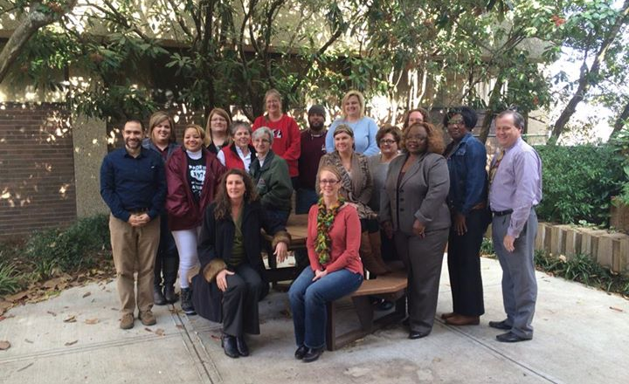

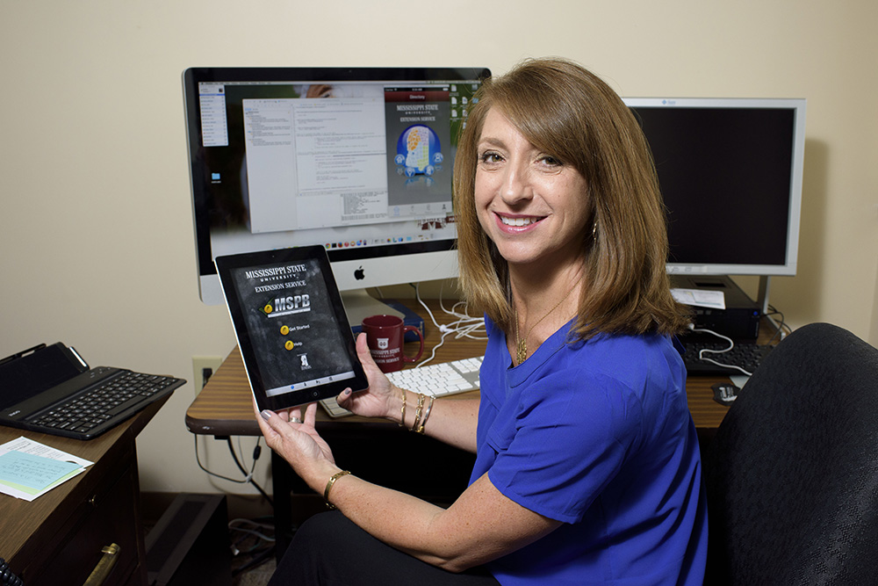
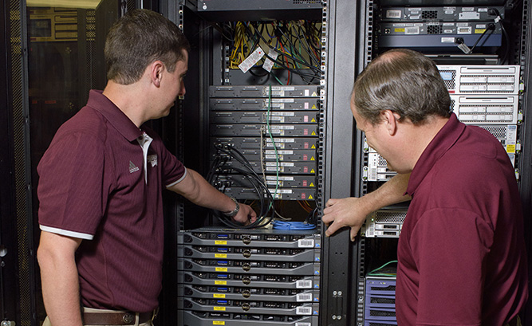
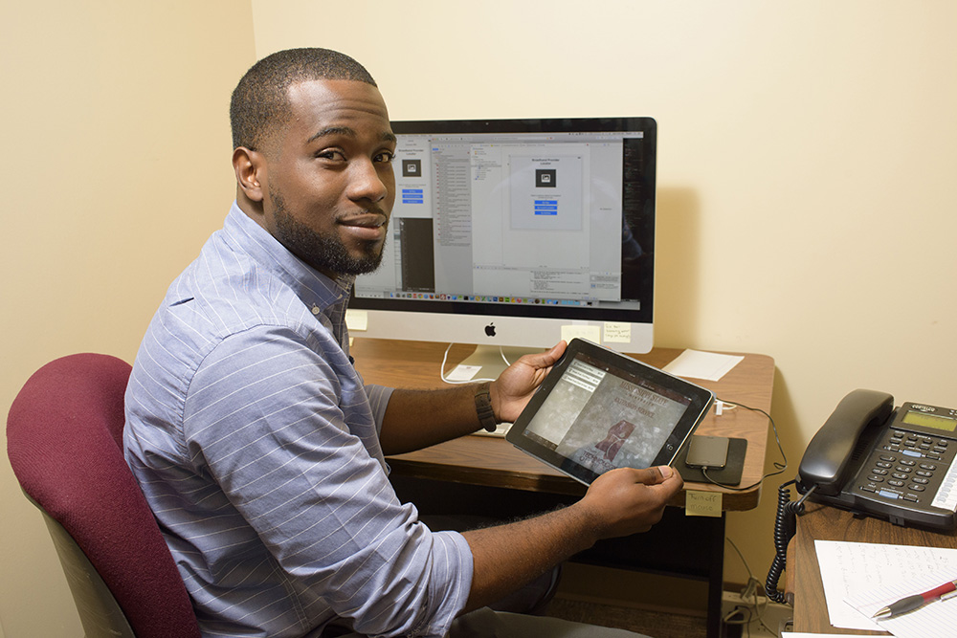
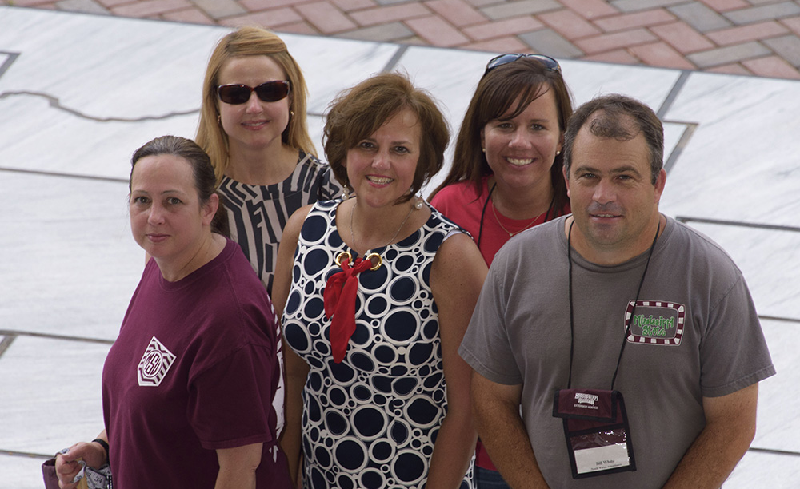
Small Gallery Template

Slide 8

Jak “Bully XXI”
(662) 325-3226
bullyxxi@msstate.edu
Bost Extension Center
Mississippi State University Extension

